Slide 1





ENZYMATIC PROCESSES IN INDUSTRIAL PRODUCTION & ITS APPLICATION
Subject:Biology for Engineers
Unit 1: Biomolecules and Enzymes
Enzyme: Cellulase
Product: "Bio-Stoned" Denim
By: Harsh Zope

Slide 2

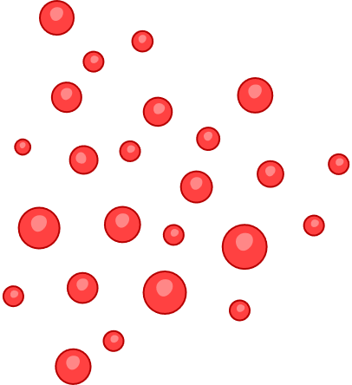

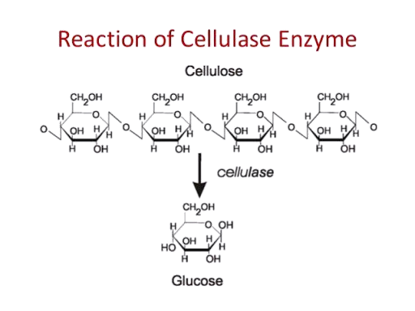
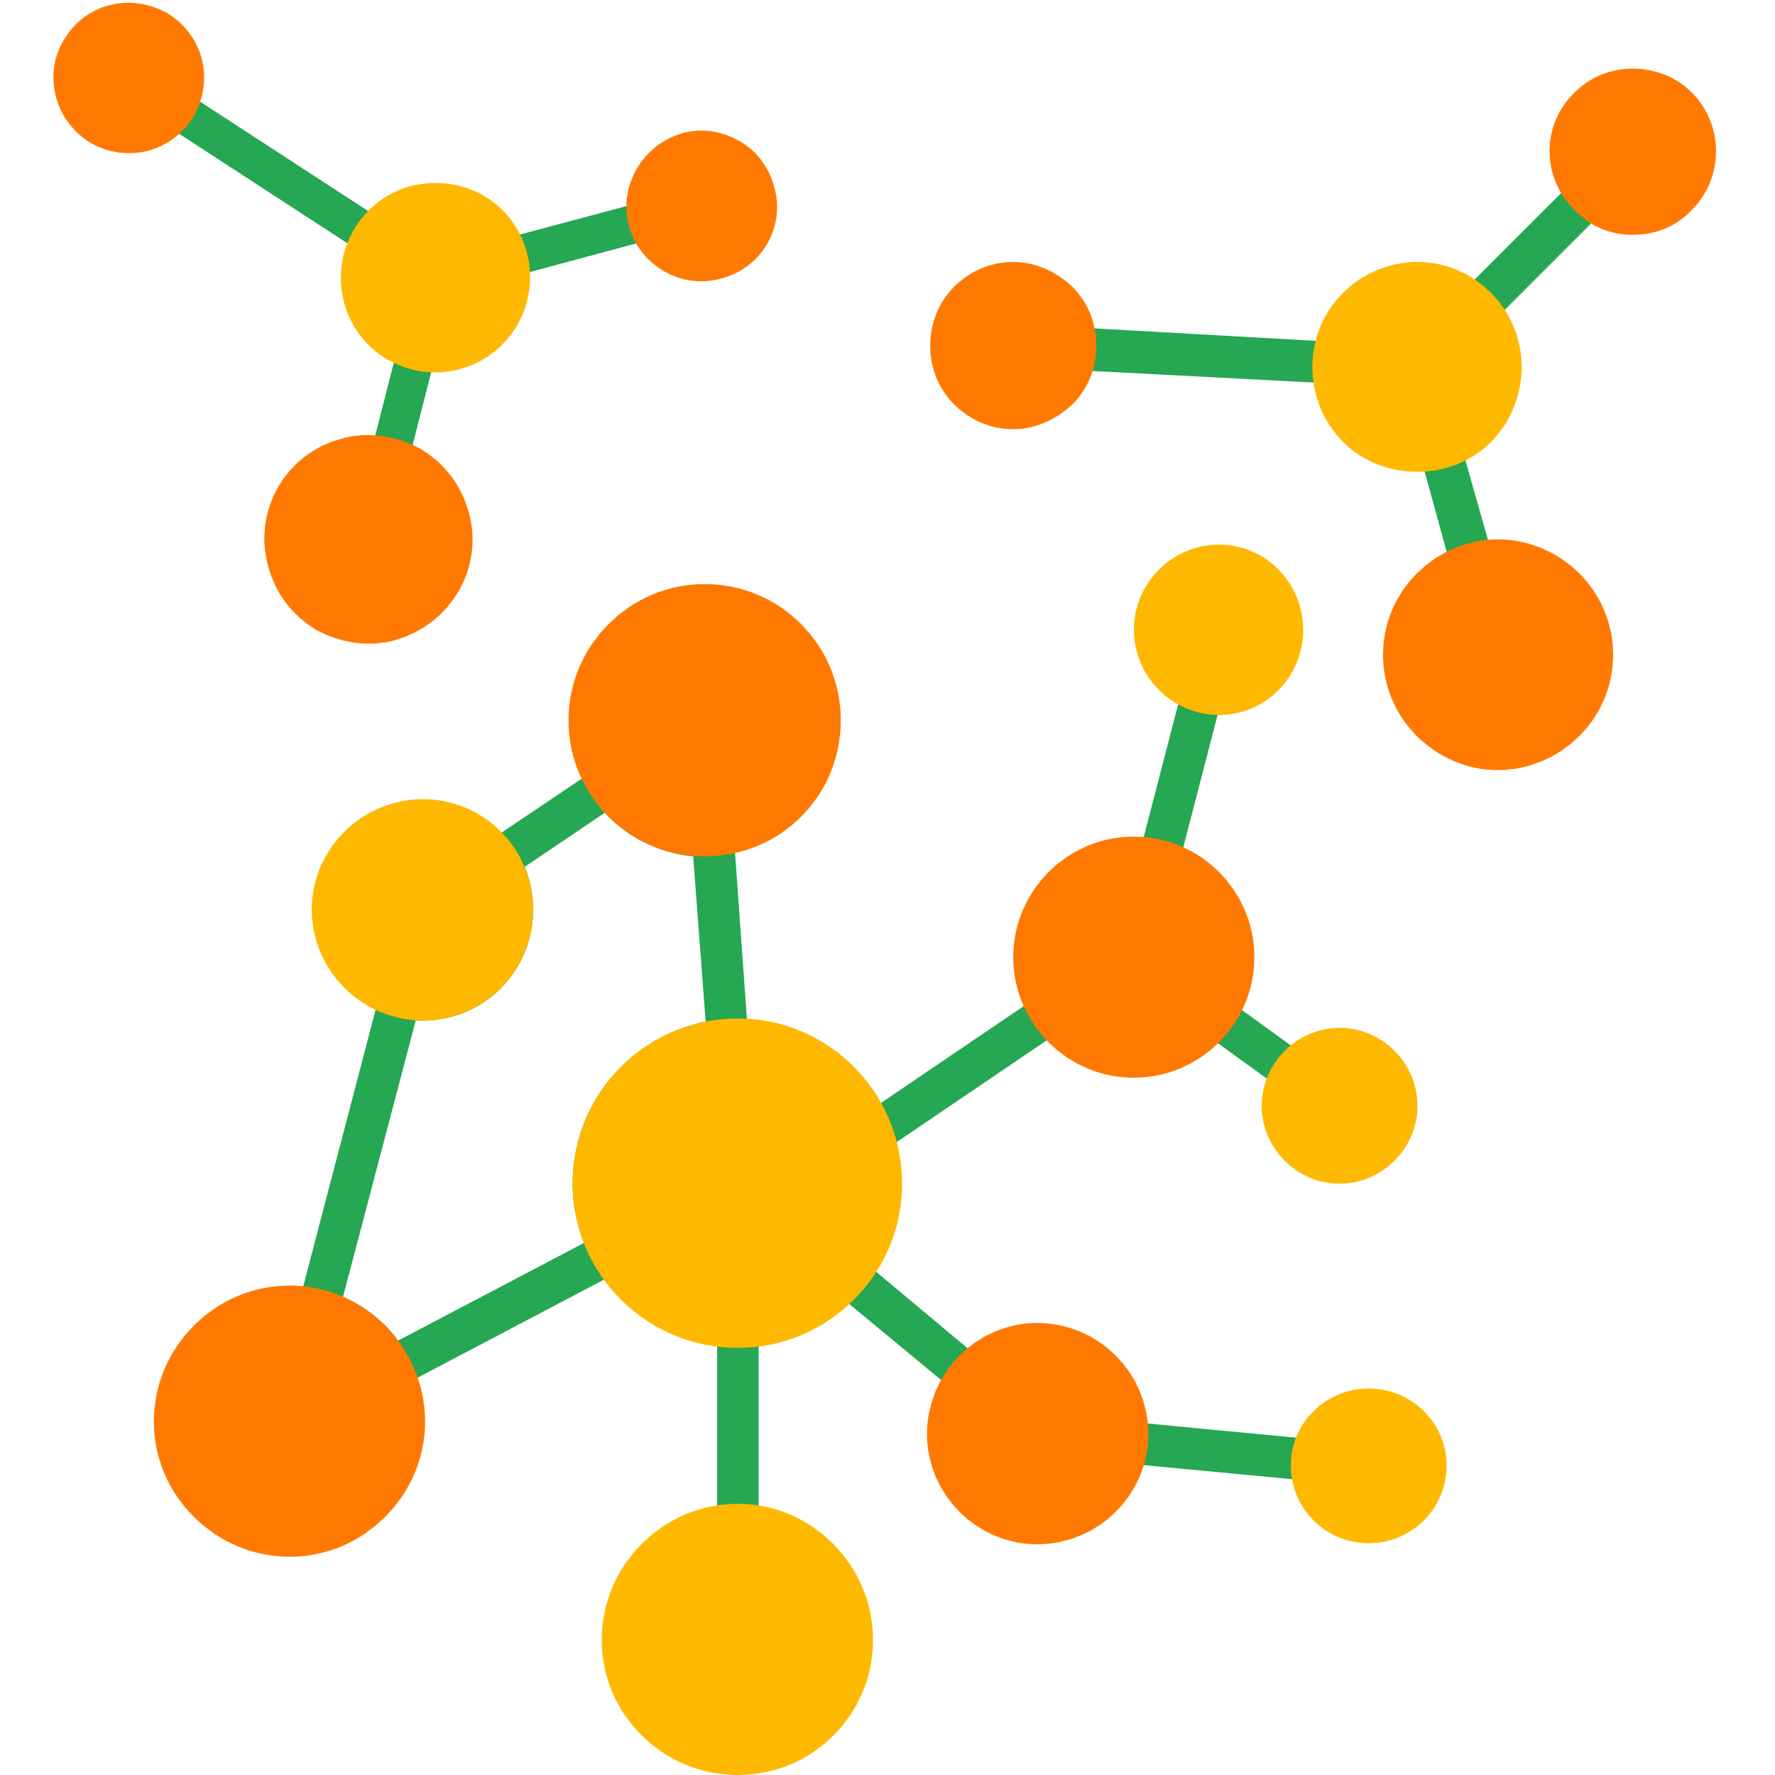
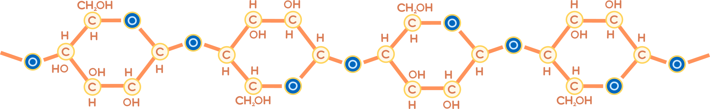
Role of Enzyme
Cellulases are enzymes which break down β -1-4-glycosidic bonds present in polysaccharide cellulose, the main component of cotton fibres. It's used in the textile industry as a more sustainable and gentle alternative to traditional pumice stone washing.

Slide 3


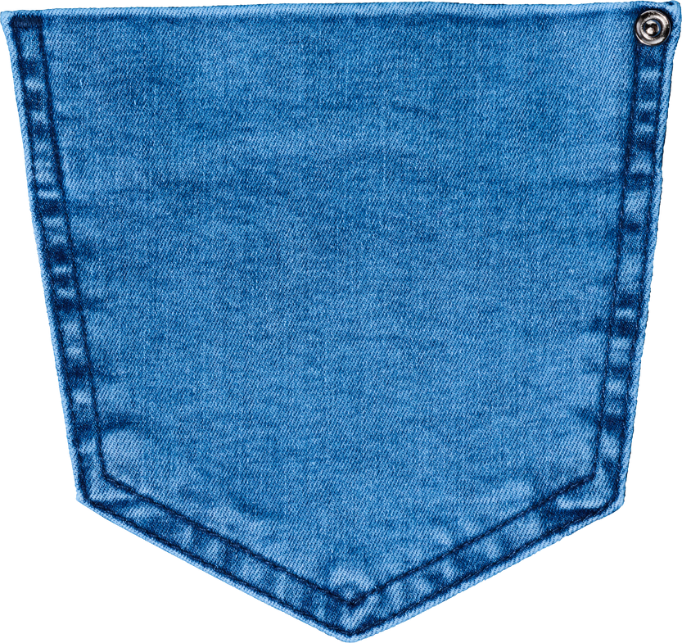


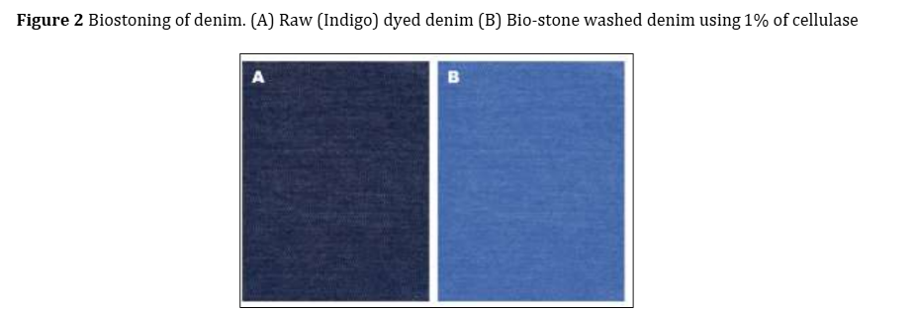


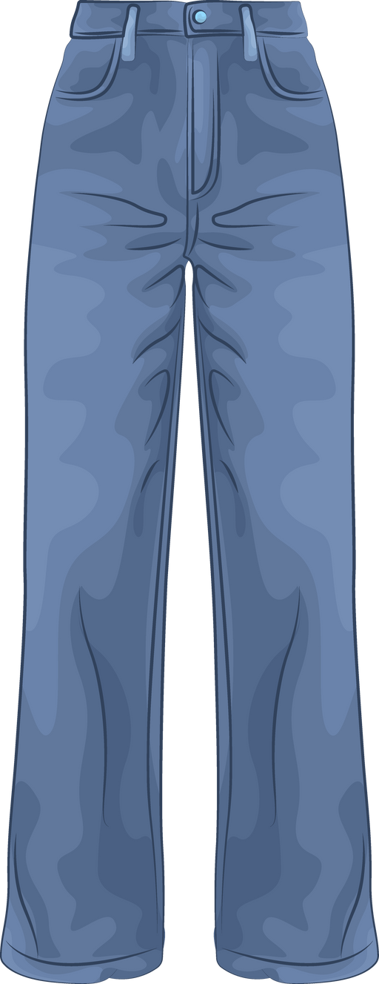
Process Conditions
The process, known as bio-stoning or enzyme washing, uses a large industrial washing machine.
Preparation: Denim garments are placed in the machine with a water bath containing the cellulase enzyme.
Enzyme Action: The drum tumbles the jeans, allowing the cellulase to gently break down the surface fibers and the indigo dye on them, creating a faded, worn-in look.
Acid Cellulase works at a pH of 4.5–5.5 and about 50°C.
Neutral Cellulase works at a pH of 6-8 and about 60°C.
Deactivation: Once the desired fading is achieved, the reaction is stopped by raising the pH or temperature to inactivate the enzyme.
Rinsing: The jeans are then rinsed to remove the enzyme and any loose dye.
The Product
(A)Raw (Indigo) dyed denim
(B)Bio-stoned denim using 1% cellulose

Slide 4
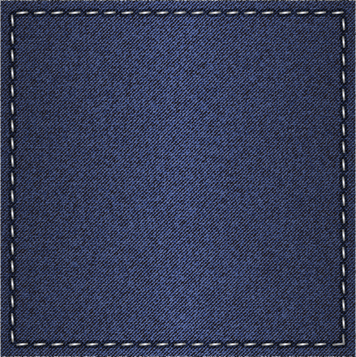




Industrial Applications
Textile Industry: Other than their bio-stoning use, Cellulases are also used for the polishing and bleaching of the fiber.
Biofuel Industry: Critical for the production of bioethanol from plant-based biomass.
Pulp and Paper Industry: Used to improve pulp properties, save energy during refining, and for deinking paper waste.
Wine Industry: In the process of maceration, cellulase is paired up with other enzymes to extract colour and flavour from grape skin

Slide 5








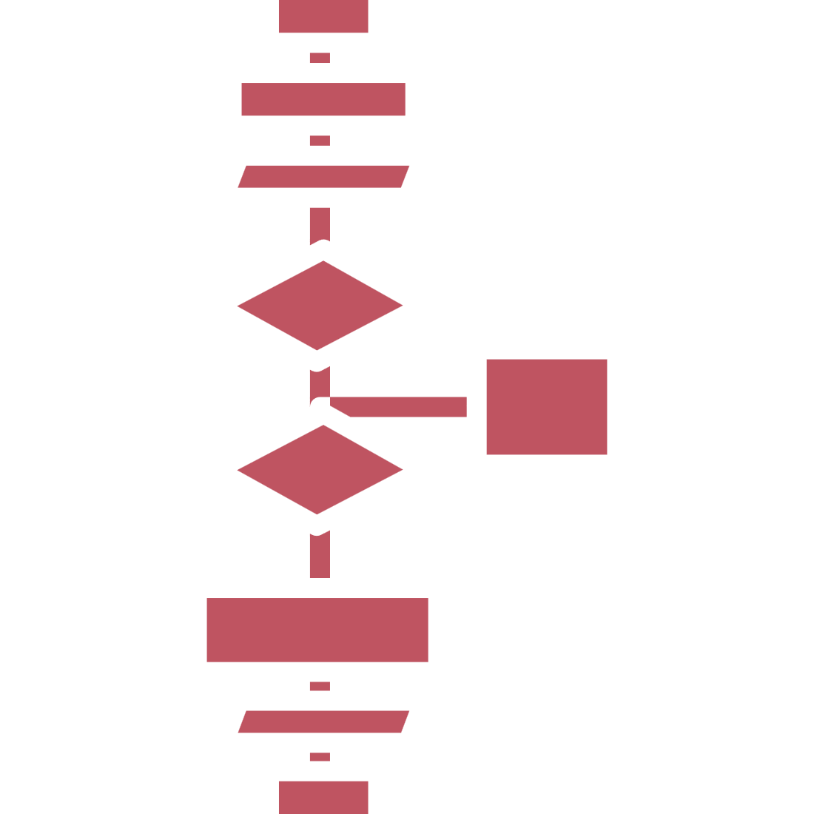

Role Of Engineer
Automation
Engineers design and program automated systems with sensors to precisely control important physical conditions such as temperature, pH, and enzyme dosage in the industrial washing machines. These systems help maintain optimal conditions which produce good quality product
Data Analysis
Software and algorithms to collect and analyze real-time data from the production process is made by engineers. The data is used to identify impurities, predict maintenance needs, and optimize the process for maximum yield and minimal resource consumption.

Slide 6






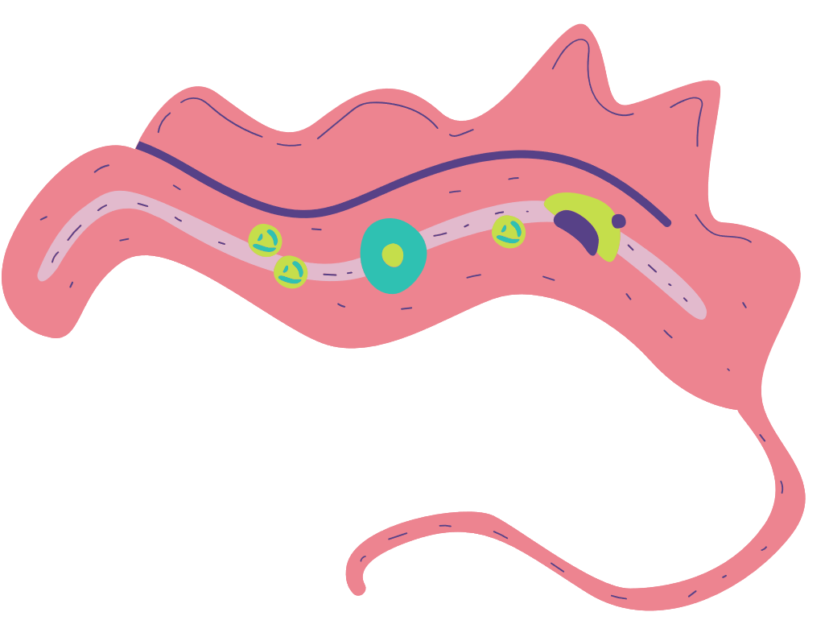


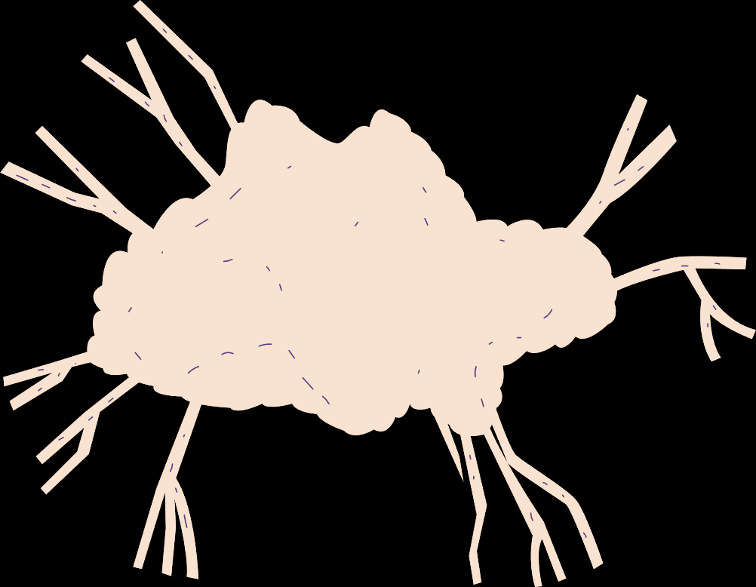

References page
https://qph.cf2.quoracdn.net/main-qimg-4123b5338c753efcd74f2601ce9b0190-lq
https://www.researchgate.net/publication/385503722_Applications_of_cellulase_enzyme_in_textile_industry_purified_from_Bacillus_paramycoides_S_5
https://www.researchgate.net/publication/350585959_Industrial_application_of_cellulases
https://textilevaluechain.in/in-depth-analysis/articles/bio-stoning-of-denim-by-enzymes
https://en.wikipedia.org/wiki/Enzyme_washing

